Slide 1

Coding with AAUP
Free PowerPoint template
By: Hussein Younis
2023

Slide 2
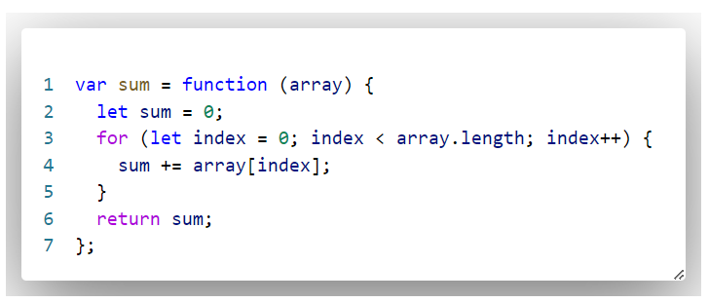
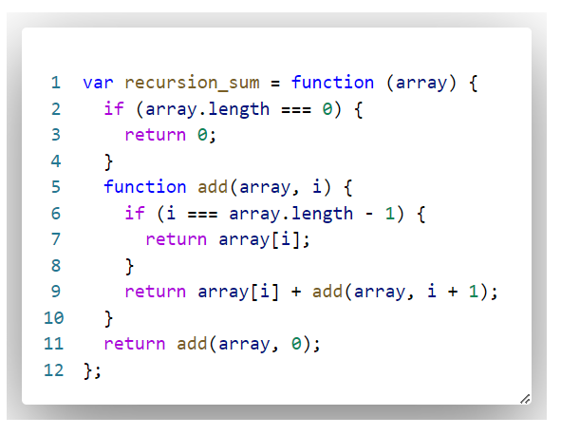
The story of Time Complexity
Both code works fine, but which one is better?

Slide 3
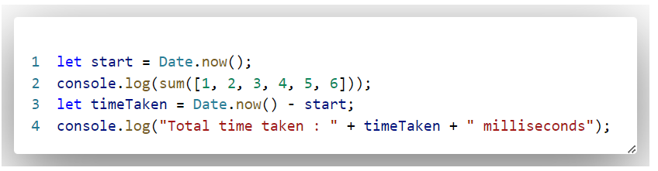
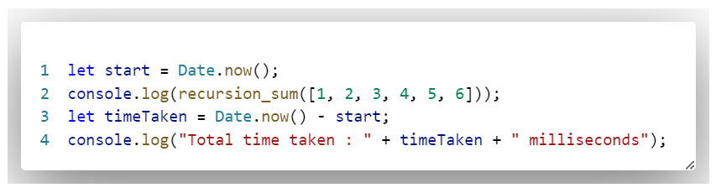
The story of Time Complexity
which one is better?

Slide 4
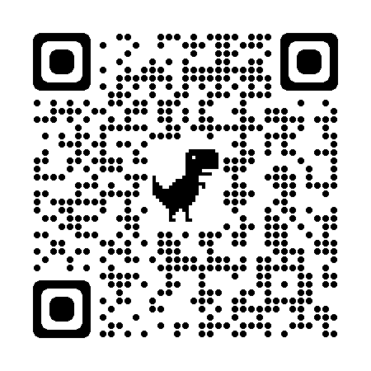
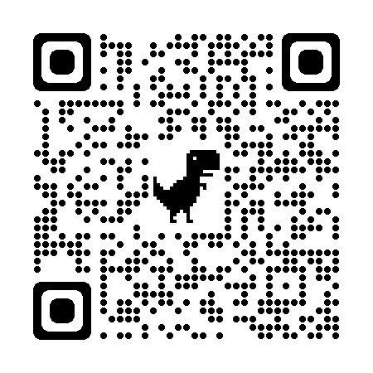
How to calculate execution time?
To integrate VSCode with c/c++
How to Install C and C++ Compilers on Windows
C/C++ for Visual Studio Code

Slide 5
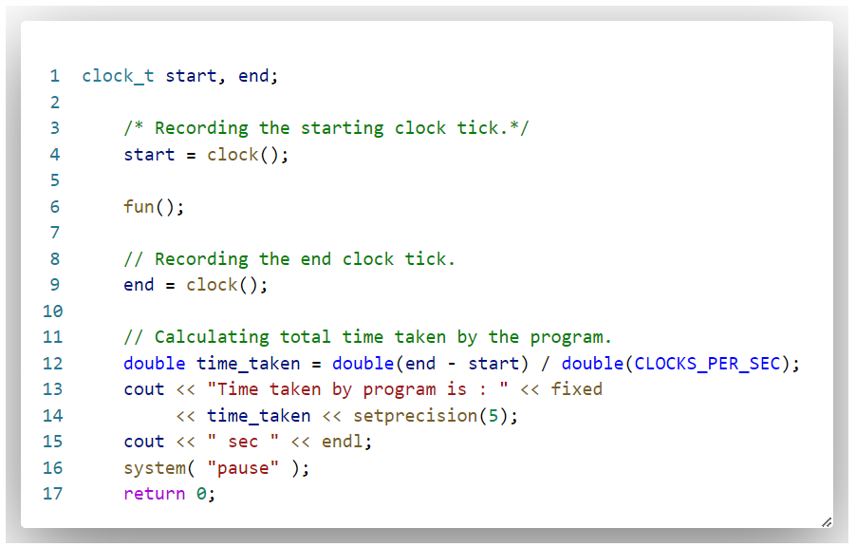
How to calculate execution time?
How to Install C and C++ Compilers on Windows

Slide 6
time complexity
The time complexity of an algorithm estimates how much time the algorithm will use for some input. The idea is to represent the efficiency as a function whose parameter is the size of the input. By calculating the time complexity, we can find out whether the algorithm is fast enough without implementing it.
O(···)
The time complexity of an algorithm is denoted

Slide 7
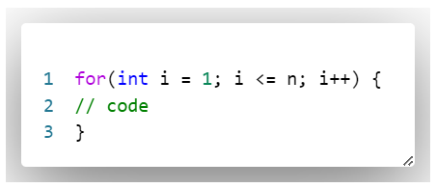
time complexity
Loops
O(n)
How many times does the loop will iterate?

Slide 8
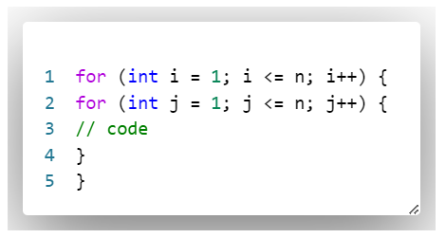
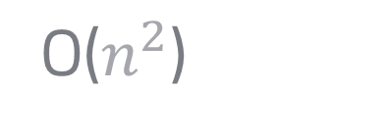
time complexity
Loops
O($n^{2}$)
If there are k nested loops, the time complexity is $O(n^{k})$

Slide 9
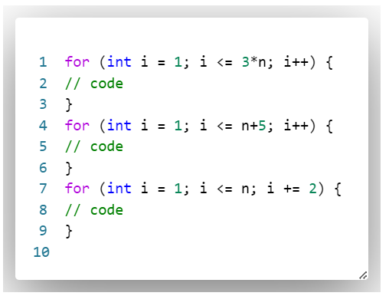
time complexity
Exercise
What is the time complexity for the following code?

Slide 10
time complexity
Exercise
What is the time complexity for the following code?
3n

Slide 11
time complexity
Exercise
What is the time complexity for the following code?
N+5

Slide 12
time complexity
Exercise
What is the time complexity for the following code?
n/2

Slide 13
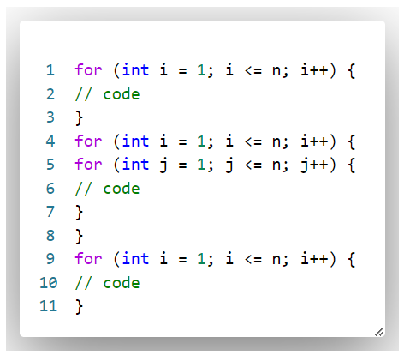
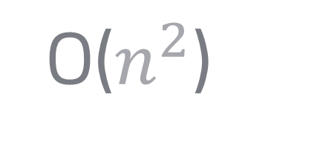
Phases
If the algorithm consists of consecutive phases, the total time complexity is the largest time complexity of a single phase. The reason for this is that the slowest phase is usually the bottleneck of the code.
O($n^{2}$)

Slide 14
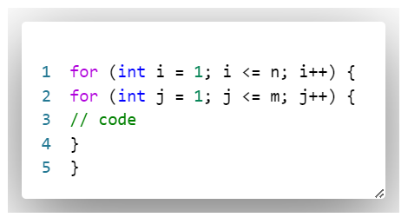
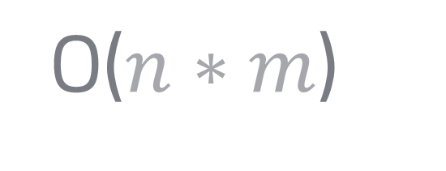
Several variables
O($n∗m$)

Slide 15
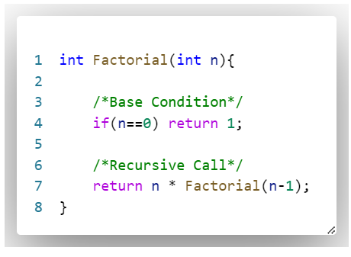
Recursion
For n = 0
If ( n==0)
Return 1
1 unit time
1 unit time
2 unit time

Slide 16
Recursion
For n > 0
If ( n==0)
Return n
Factorial (n-1)
1 unit time
1 unit time
1 unit time (for call)
3 unit time + time of Factorial (n-1)

Slide 17







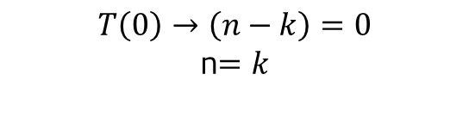
Recursion
For n = 5
$$T\left(5\right)=3+T(4)$$
$$T\left(4\right)=6+T(3)$$
$$T\left(3\right)=9+T(2)$$
$$T\left(2\right)=12+T(1)$$
$$T\left(1\right)=15+T(0)$$
$$T\left(n\right)=3∗k+T(n−k)$$
$$T\left(0\right)→\left(n−k\right)=0$$
n$=k$
$$T\left(n\right)=3n+2$$

Slide 18
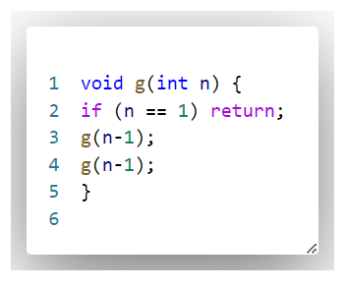



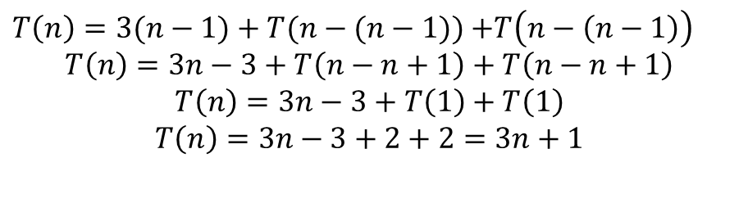
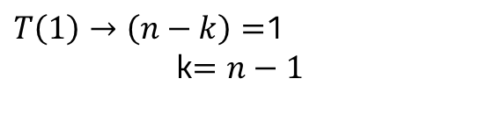

Recursion
Assume that n = 4
For stop condition
$$T\left(1\right)=2$$
$$T\left(4\right)=3+T\left(3\right)+T\left(3\right)$$
$$T\left(3\right)=6+T\left(2\right)+T\left(2\right)$$
$$T\left(2\right)=9+T\left(1\right)+T\left(1\right)$$
$T\left(n\right)=3∗k+T(n−k)$ $+T(n−k)$
$T\left(1\right)→\left(n−k\right)=$1
k$=n−1$
$T\left(n\right)=3(n−1)+T(n−(n−1))$ $+T\left(n−\left(n−1\right)\right)$
$$T\left(n\right)=3n−3+T\left(n−n+1\right)+T\left(n−n+1\right)$$
$$T\left(n\right)=3n−3+T\left(1\right)+T\left(1\right)$$
$$T\left(n\right)=3n−3+2+2=3n+1$$

Slide 19
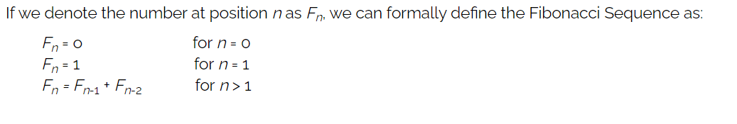
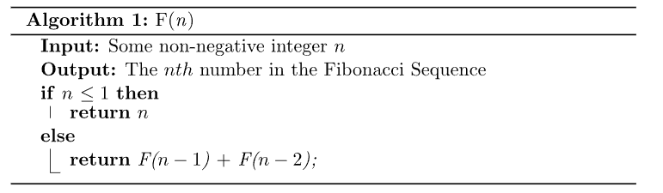
Recursion(Fibonacci Sequence)

Slide 20
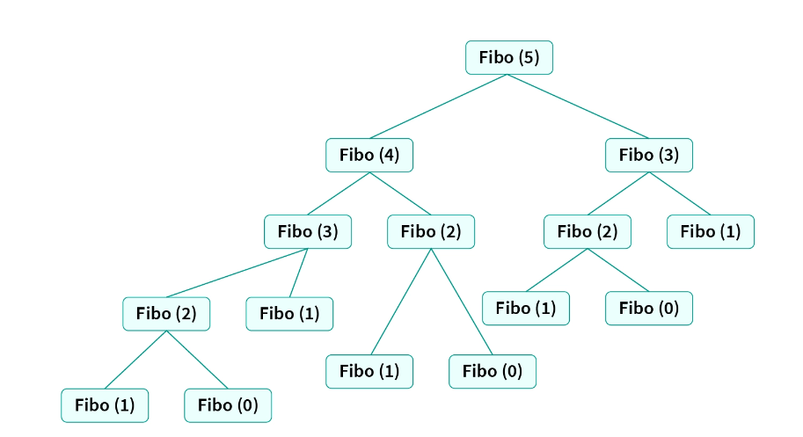
Recursion(Fibonacci Sequence)

Slide 21
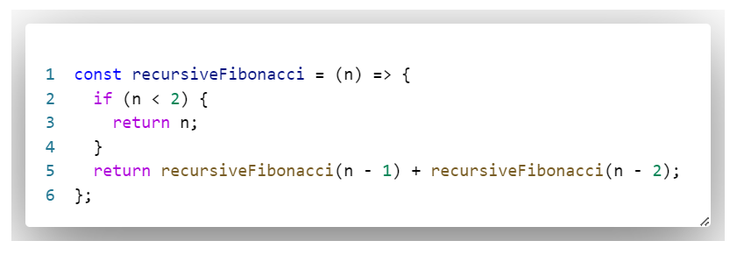
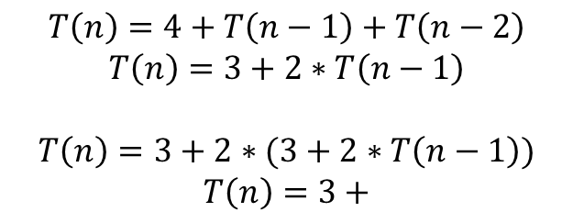

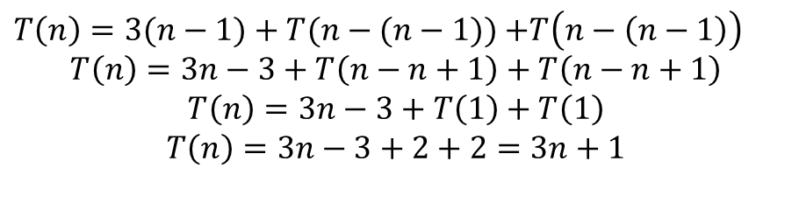
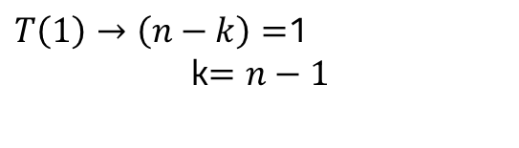
Recursion
Assume that n = 5
$$T\left(1\right)=T\left(0\right)=1$$
$$T\left(n\right)=4+T\left(n−1\right)+T\left(n−2\right)$$
$$T\left(n\right)=3+2∗T\left(n−1\right)$$
$$T\left(n\right)=3+2∗(3+2∗T\left(n−1\right))$$
$$T\left(n\right)=3+$$
$T\left(1\right)→\left(n−k\right)=$1
k$=n−1$
$T\left(n\right)=3(n−1)+T(n−(n−1))$ $+T\left(n−\left(n−1\right)\right)$
$$T\left(n\right)=3n−3+T\left(n−n+1\right)+T\left(n−n+1\right)$$
$$T\left(n\right)=3n−3+T\left(1\right)+T\left(1\right)$$
$$T\left(n\right)=3n−3+2+2=3n+1$$

Slide 22


First problem:
Equal Left and Right Subarray Sum
This problem form:

Slide 23
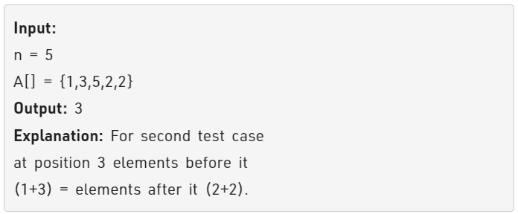
First problem:
Equal Left and Right Subarray Sum
Given an array A of n positive numbers. The task is to find the first index in the array such that the sum of elements before it is equal to the sum of elements after it.
The task is to complete the function equalSum() which takes the array and n as input parameters and returns the point. Return -1 if no such point exists.

Slide 24
Problem analysis:
Equal Left and Right Subarray Sum
1- input domain
If array is empty
From definition, The function will always return -1

Slide 25
Problem analysis:
Equal Left and Right Subarray Sum
1- input domain
If array contains just one element
The left sum = 0 and the right sum = 0
Which mean that the index is always equal to 0

Slide 26
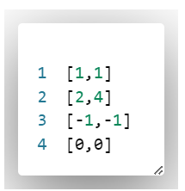
Problem analysis:
Equal Left and Right Subarray Sum
1- input domain
If array contains just two element
For line 1: left sum for index 0 = 0
Right sum for index 0 = 1
For line 1: left sum for index 1 = 1
Right sum for index 1 = 0
The function must Return -1

Slide 27
Problem analysis:
Equal Left and Right Subarray Sum
1- input domain
If array contains just two element
For line 2: left sum for index 0 = 0
Right sum for index 0 = 4
For line 2: left sum for index 1 = 2
Right sum for index 1 = 0
The function must Return -1

Slide 28
Problem analysis:
Equal Left and Right Subarray Sum
1- input domain
If array contains just two element
Form definition the array just contains positive number
The function must Return -1

Slide 29
Problem analysis:
Equal Left and Right Subarray Sum
1- input domain
If array contains just two element
For line 4: left sum for index 0 = 0
Right sum for index 0 = 4
For line 4: left sum for index 1 = 0
Right sum for index 1 = 0
The function must Return 0

Slide 30
Problem analysis:
Equal Left and Right Subarray Sum
1- input domain
If array contains more than two element
for each element a[i] in array do the following:
Assume left Sum = 0 and right sum = 0.
calculate the summation from 0 index to i as left sum.
calculate the summation from (i+1) index to array length -1 as right sum.
If left sum equal to right sum return i.
Return -1.

Slide 31
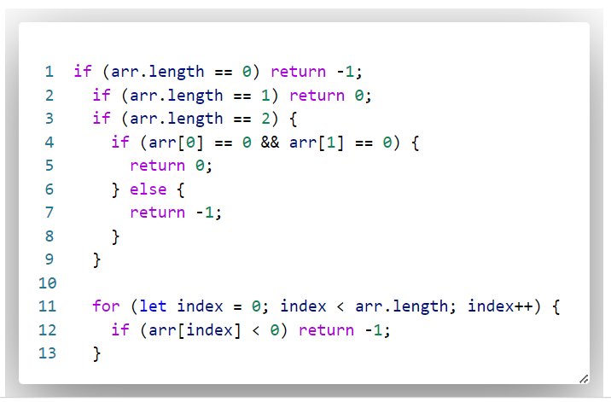
Problem coding:
Constraints and conditions

Slide 32
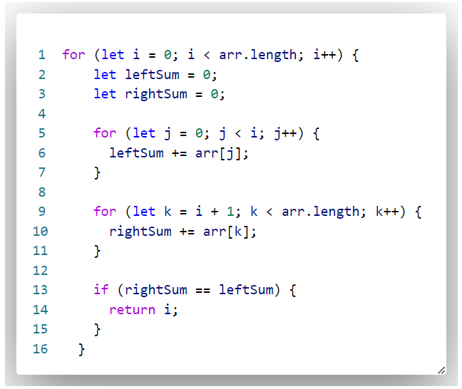
Problem coding:
problem implementation

Slide 33
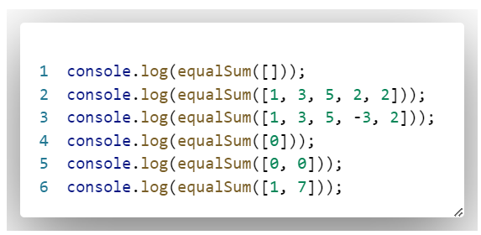
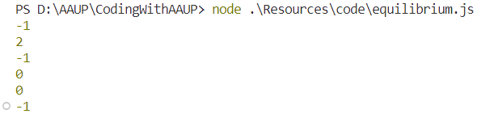
Problem coding:
Test code

Slide 34
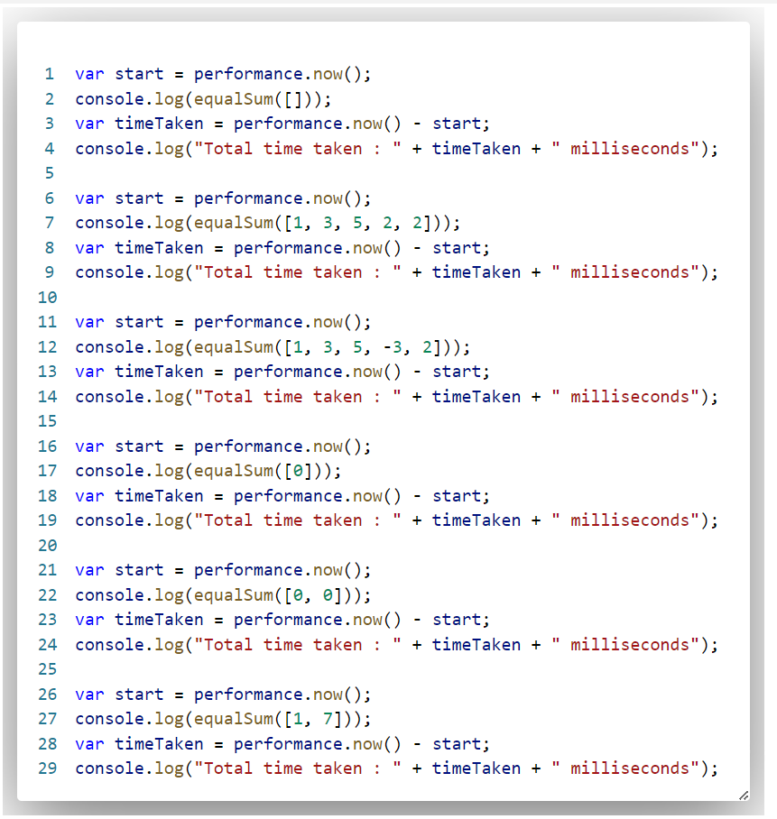
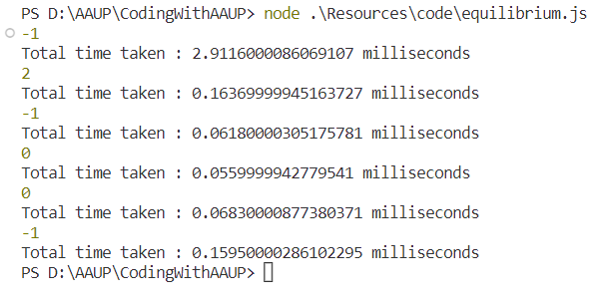
Problem coding:
Execution time analysis

Slide 35
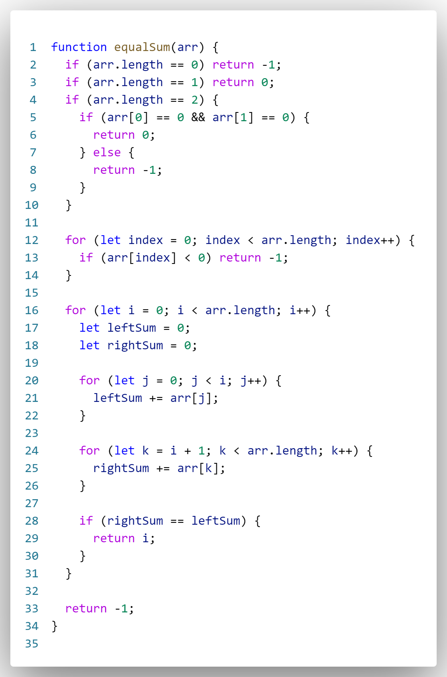
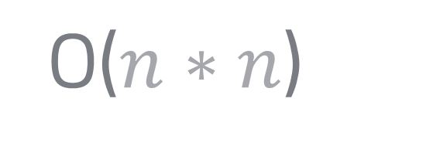
2 unit time if satisfied otherwise 1 unit time
2 unit time if satisfied otherwise 1 unit time
If first if not satisfied, it will take1 unit time
If first if is satisfied:
And if second if not satisfied, it will take 3 unit time.
If second if is satisfied, it will take 4 unit time.
Array length unit time
Each time the second and the third loop will iterate array length time.
The time = array length (array length + 3)
O($n∗n$)

Slide 36
What will happen if we delete this condition?

Slide 37
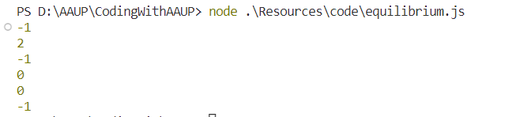
What will happen if we delete this condition?

Slide 38
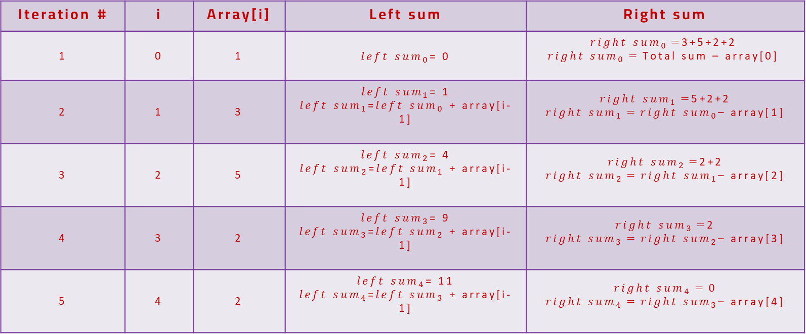
Digging more!
Total sum = 1+3+5+2+2=13
array
index | 0 | 1 | 2 | 3 | 4
value | 1 | 3 | 5 | 2 | 2
Iteration # | i | Array[i] | Left sum | Right sum
1 | 0 | 1 | ${left sum}_{0}$= 0 | ${right sum}_{0}=$3+5+2+2 $${right sum}_{0}=\text{Total} \text{sum} \text{– }\text{array}\text{[}\text{0}\text{]}$$
2 | 1 | 3 | ${left sum}_{1}$= 1 ${left sum}_{1}$=${left sum}_{0}$ + array[i-1] | ${right sum}_{1}=$5+2+2 $${right sum}_{1}={right sum}_{0}\text{– }\text{array}\text{[}\text{1}\text{]}$$
3 | 2 | 5 | ${left sum}_{2}$= 4 ${left sum}_{2}$=${left sum}_{1}$ + array[i-1] | ${right sum}_{2}=$2+2 $${right sum}_{2}={right sum}_{1}\text{– }\text{array}\text{[}\text{2}\text{]}$$
4 | 3 | 2 | ${left sum}_{3}$= 9 ${left sum}_{3}$=${left sum}_{2}$ + array[i-1] | ${right sum}_{3}=$2 $${right sum}_{3}={right sum}_{2}\text{– }\text{array}\text{[}\text{3}\text{]}$$
5 | 4 | 2 | ${left sum}_{4}$= 11 ${left sum}_{4}$=${left sum}_{3}$ + array[i-1] | $${right sum}_{4}=0$$ $${right sum}_{4}={right sum}_{3}\text{– }\text{array}\text{[}\text{4}\text{]}$$

Slide 39
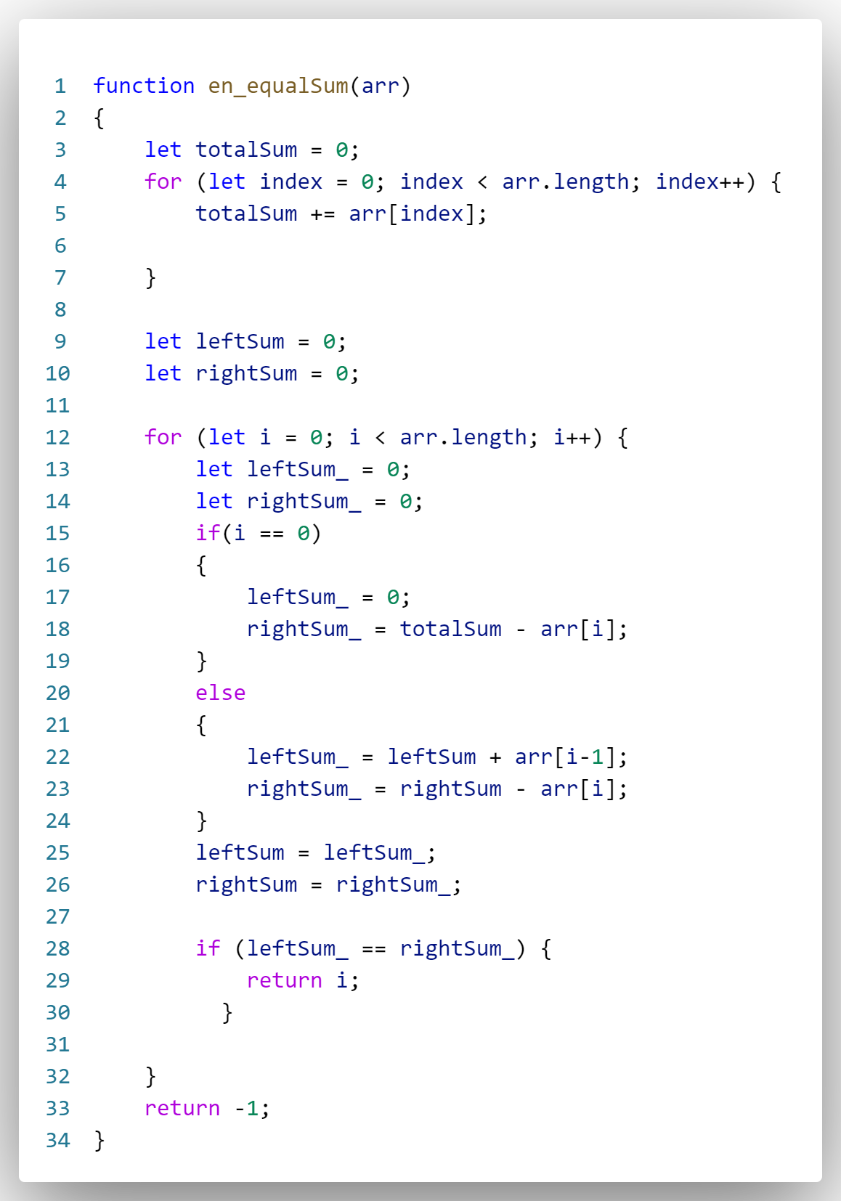
Digging more!
What is the time complexity?

Slide 40

Second problem:
A. Even Odds
This problem form:

Slide 41
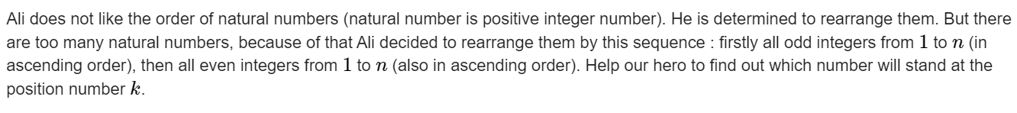
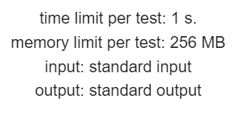
Second problem:
A. Even Odds

Slide 42
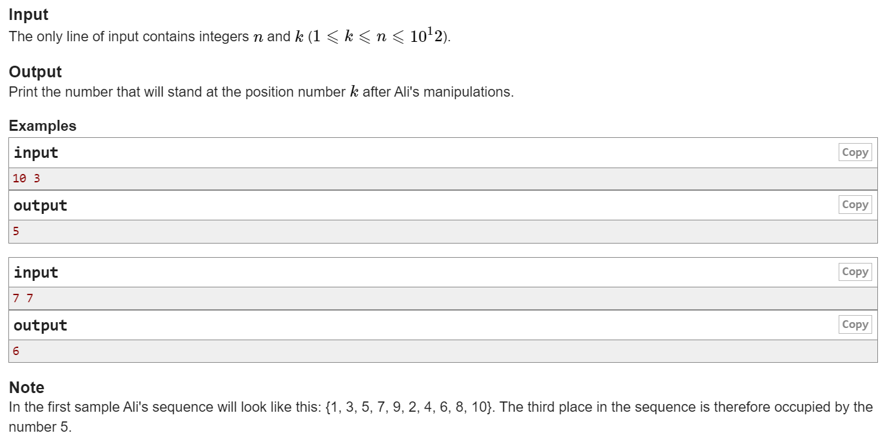
Second problem:
A. Even Odds

Slide 43
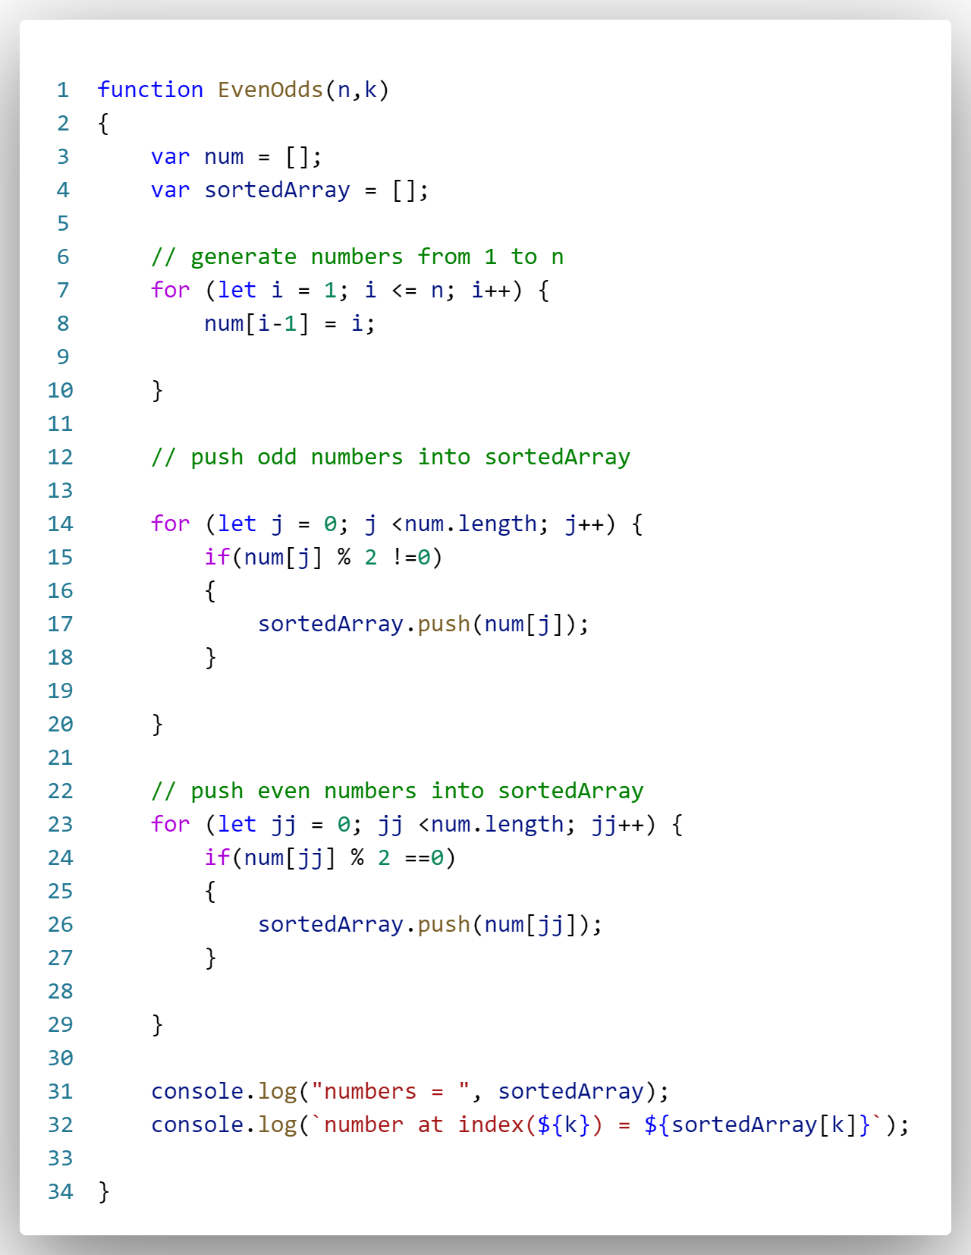
Second problem:
A. Even Odds
Its easy just generate the numbers from 1 to n and then push the odd number to an array and then push even number, and finally return the value at k index!

Slide 44
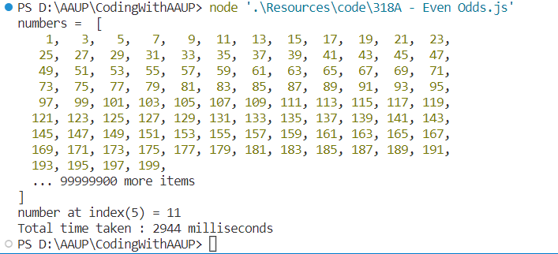
Second problem:
A. Even Odds
Wait!!! Time limit error!!
2944 ms = 2.944 s

Slide 45
Problem analysis:
A. Even Odds
1- input domain
For n [ n may be odd or even ]
If n is even
n | numbers | Ali order | #’s of odd | #’s of even
2 | 1, 2 | 1, 2 | 1 | 1
4 | 1, 2, 3, 4 | 1, 3 , 2 ,4 | 2 | 2
6 | 1, 2, 3, 4, 5, 6 | 1, 3, 5, 2, 4, 6 | 3 | 3
8 | 1, 2, 3, 4, 5, 6, 7, 8 | 1, 3, 5, 7, 2, 4, 6, 8 | 4 | 4
10 | 1, 2, 3, 4, 5, 6, 7, 8, 9, 10 | 1, 3, 5, 7,9, 2, 4, 6, 8, 10 | 5 | 5

Slide 46
Problem analysis:
A. Even Odds
1- input domain
For n [ n may be odd or even ]
If n is odd
n | numbers | Ali order | #’s of odd | #’s of even
1 | 1 | 1 | 1 | 0
3 | 1, 2, 3 | 1, 3 , 2 | 2 | 1
5 | 1, 2, 3, 4, 5 | 1, 3, 5, 2, 4 | 3 | 2
7 | 1, 2, 3, 4, 5, 6, 7 | 1, 3, 5, 7, 2, 4, 6 | 4 | 3
9 | 1, 2, 3, 4, 5, 6, 7, 8, 9 | 1, 3, 5, 7,9, 2, 4, 6, 8 | 5 | 4

Slide 47
Problem analysis:
A. Even Odds
1- input domain
For n [ n may be odd or even ]
If n is even , the midpoint = n /2 , odd number position from 1 to midpoint (included) and even number position from midpoint+1 to n
If n is odd , the midpoint = (n /2)+1 , odd number index from 0 to midpoint(included) and even number index from midpoint+1 to n

Slide 48
Problem analysis:
A. Even Odds
1- input domain
Relationship between position and number
position | 1 | 2 | 3 | 4 | 5 | 6 | 7 | 8 | 9 | 10
number | 1 | 2 | 3 | 4 | 5 | 6 | 7 | 8 | 9 | 10
After sorting
position | 1 | 2 | 3 | 4 | 5 | 6 | 7 | 8 | 9 | 10
number | 1 | 3 | 5 | 7 | 9 | 2 | 4 | 6 | 8 | 10
Mid point
If position > midpoint → the number is even
If position <= midpoint → the number is odd

Slide 49
Problem analysis:
A. Even Odds
1- input domain
Relationship between position and number
position | 1 | 2 | 3 | 4 | 5 | 6 | 7
number | 1 | 2 | 3 | 4 | 5 | 6 | 7
After sorting
position | 1 | 2 | 3 | 4 | 5 | 6 | 7
number | 1 | 3 | 5 | 7 | 2 | 4 | 6
Mid point
If position > midpoint → the number is even
If position <= midpoint → the number is odd

Slide 50
Problem analysis:
A. Even Odds
1- input domain
If n is odd = 7
position | 1 | 2 | 3 | 4 | 5 | 6 | 7
number | 1 | 3 | 5 | 7 | 2 | 4 | 6
odd number
Mid point
Even number
When position k is odd
position 1 → 1
position 2 → 3
position 3→ 5
position 4 → 7
When position k is even
position 5 → 2
position 6 → 4
position 7→ 6
(k - midpoint) *2
(2 * k ) -1

Slide 51
Problem analysis:
A. Even Odds
1- input domain
If n is even = 6
position | 1 | 2 | 3 | 4 | 5 | 6
number | 1 | 3 | 5 | 2 | 4 | 6
odd number
Mid point
Even number
When position k is odd
position 1 → 1
position 2 → 3
position 3→ 5
When position k is even
position 4 → 2
position 5 → 4
position 6→ 6
(k - midpoint) *2
(2 * k ) -1

Slide 52
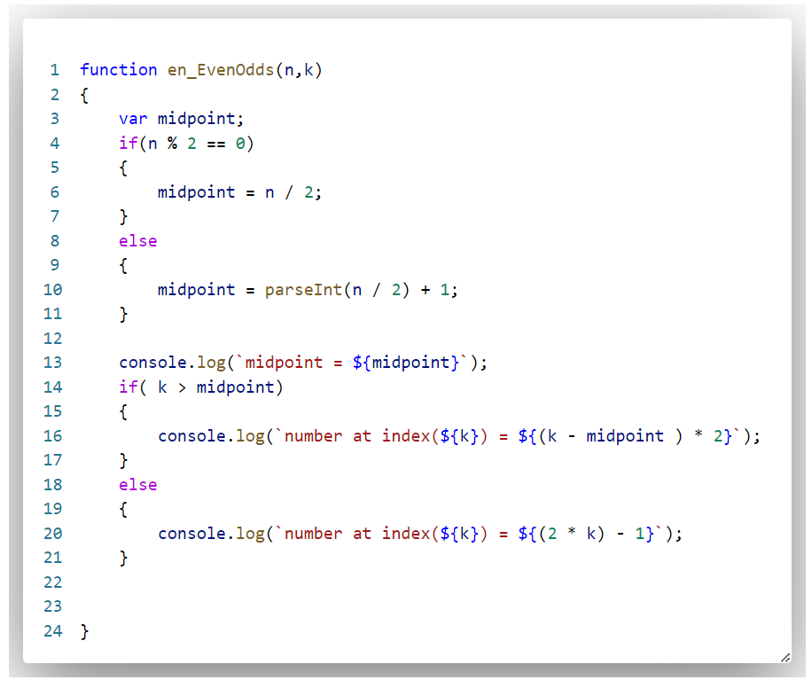
Problem analysis:
A. Even Odds

Slide 53
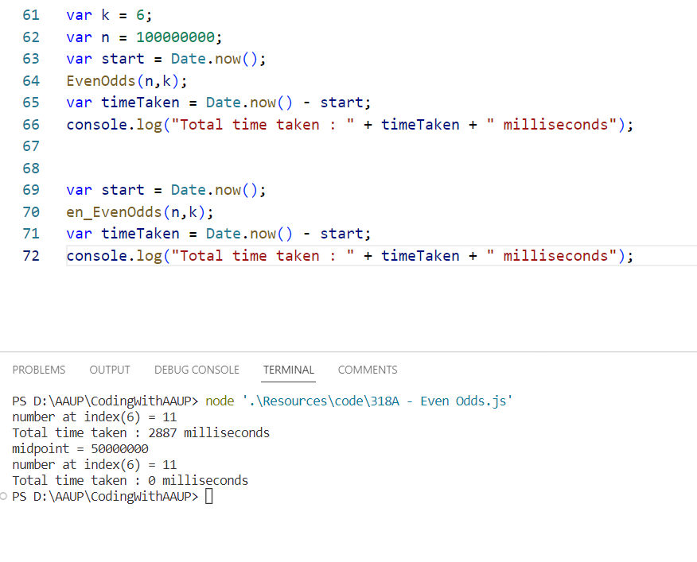
Problem analysis:
A. Even Odds

